Slide 1

SEASONS
Made by:
Debreczeni Barnabas & Hugyecz Mate

Slide 2
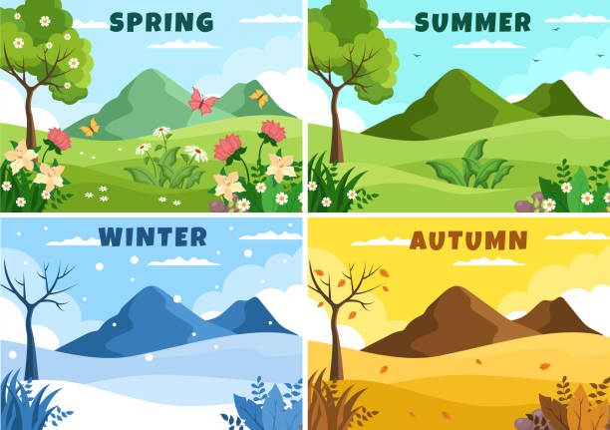
WINTER VS SPRING VS SUMMER VS AUTUMN COMAPRISON

Slide 3
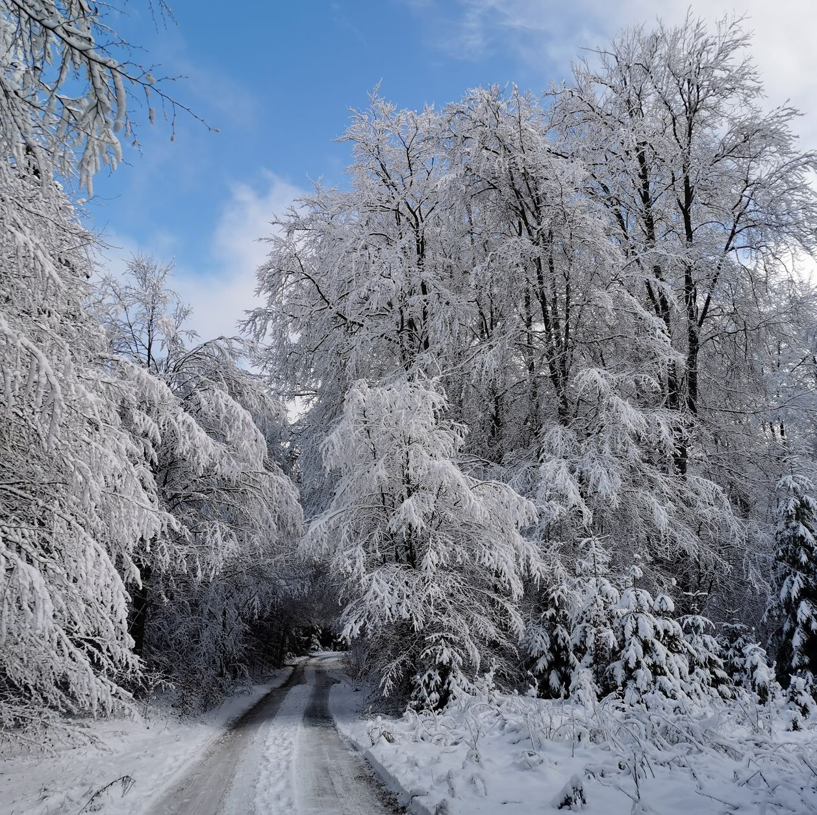
Winter
Weather conditions: Cold Temperatures, Snow and sometimes Ice storms, blizzard, sleet, freezing, foggy, shorter days
Clothing: Coats, Jackets, Hats, Scarves, Gloves and Warm Underwear, Boots, ski mask
Outdoor Activities:
Skiing, Snowboarding, Ice skating, Sledding, snow mobile, building a snowman

Slide 4
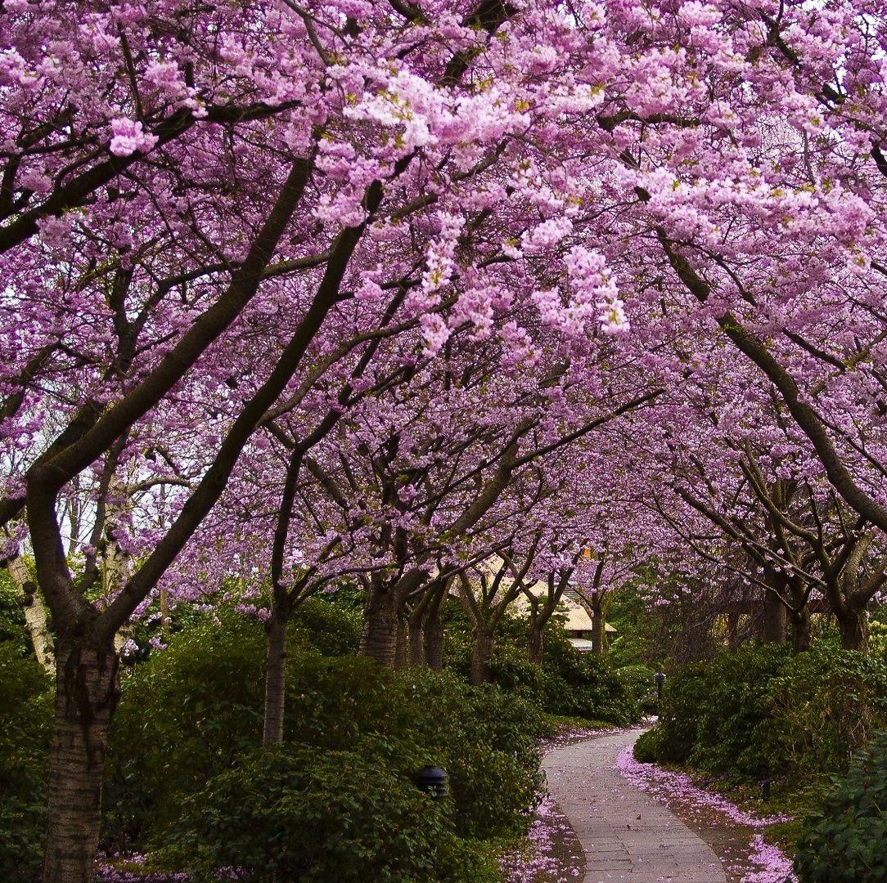
SPRING
Weather conditions: Unpredictable, Sunny days may be followed by a week of stormy weather, windy, rainy, pollens
Clothing: Jeans, Sweaters, Thin Coats, Jackets, Trousers, Sneakers, Boots
Outdoor Activities: Camping, Hiking, Cycling, Going on a Picnic, Gardening (digging, planting)

Slide 5
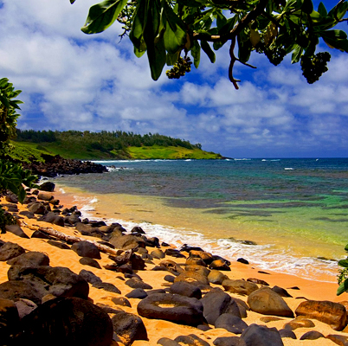
SUMMER
Weather conditions: The Warmest Season, Sunny, Generally Hot, Occasionaly Thunderstorms, hail storms, pollens
Clothing: T-shirts, tops, skirts, Shorts, Sneakers, sandals, slippers (flipflops, mules) hats, sunglasses, baseball cap
Outdoor Activities: Fishing, Swimming, Barbecue, Going to the Beach, Surfing, jetskiing, waterskiing, hiking,

Slide 6
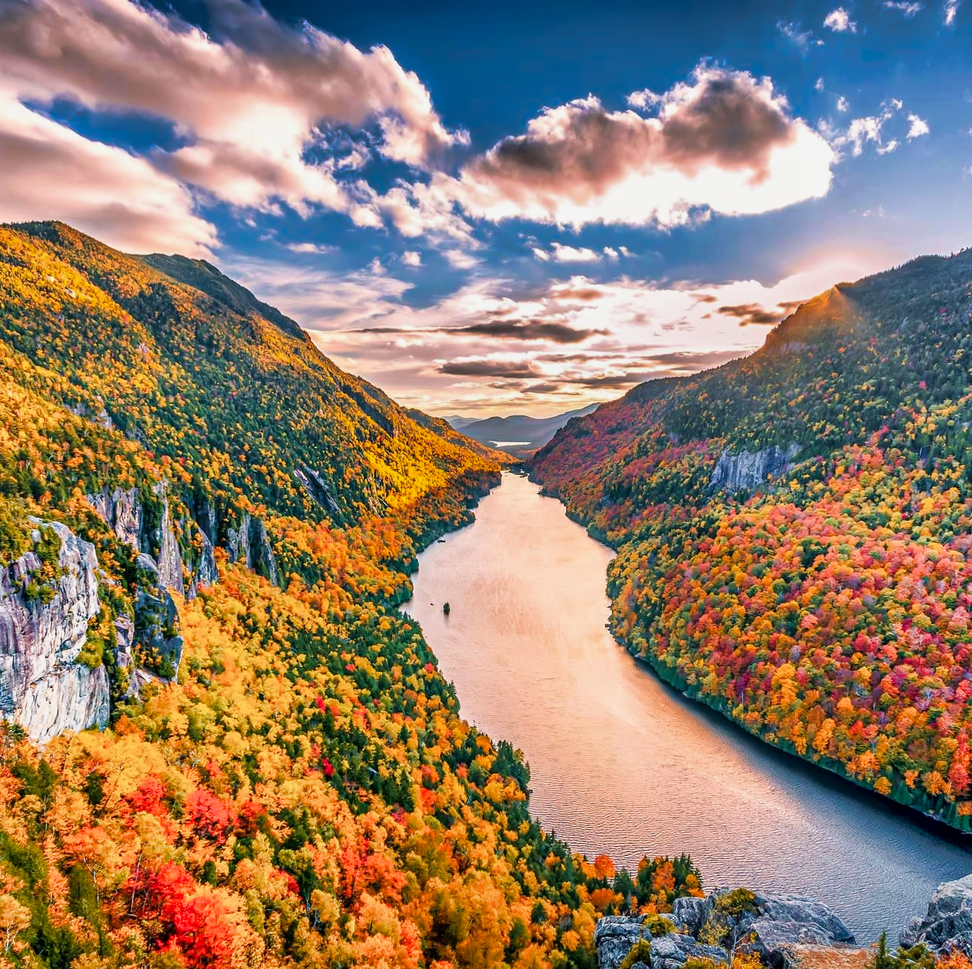
AUTUMN
Weather conditions: The Weather gets Colder, Windy and Rainy, foggy
Clothing: Sweatshirts, Jackets, Coats, Cardigans, Boots, Trousers, Jeans, Hats
Outdoor Activities: Pumpkin Carving, Planting Flower Bulbs, Watching the Sunset/Sunrise, harvesting

Slide 7
THANK YOU FOR THE ATTENTION!

